Slide 1
ePortfolio: Webpage Design
Webpage can be accessed at (and compatible on most devices): https://matthewliu2000.github.io/page/
Github Repository:
https://github.com/matthewliu2000/page/
By Matthew Liu
ECE 3005 - Christina M Bourgeois
GTA – Austin Xu

Slide 2
Table of Contents
Motivation and Introduction
Development
Tools used in development
Work Flow demonstration
Design (Theme, Navigation, Organization, etc.)
Future Work on Webpage
Exhibition of Required Components

Slide 3
Motivation and Introduction

Slide 4

How I believe a website will help me in securing a job/internship

Slide 5
Websites are important today for sharing knowledge, influencing others, and improving credibility
For Collective Entities and Businesses
Marketing, ease-of access to information, professionalism, online presence, establish credibility
Increase visibility
For Individuals
Increase Online Visibility
Professional Development

Slide 6
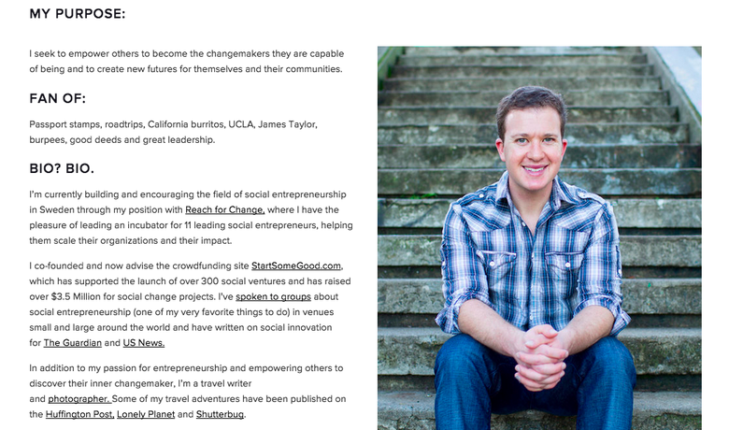
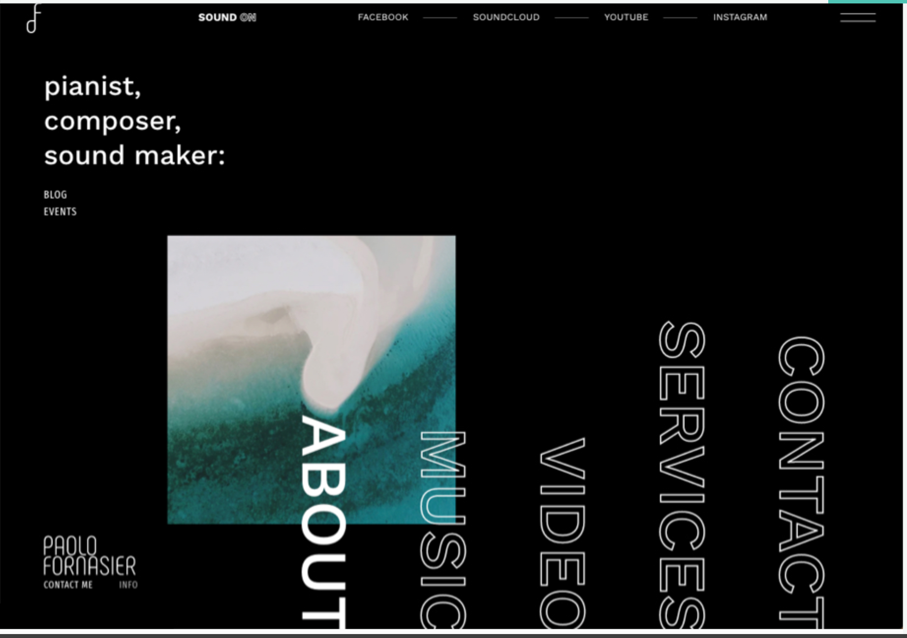
A good website pays attention to color, navigation, organization, multi-platform friendliness, typography, and overall usability
Creativity
Effectiveness

Slide 7
Development

Slide 8
Github Pages hosts my webpage
Static site hosting service that takes HTML, CSS, and JavaScript files.
Runs the files through a build process, and publishes the website to allow access to people online
https://github.com/collections/github-pages-examples

Slide 9
Markdown and Jekyll
Markdown is a text-to-HTML converter that let’s you write text naturally in plain text format and then convert it to valid HTML.
Using Jekyll, content for pages and posts can be written in either HTML or Markdown.
Text Editors:
Visual studio code for good auto syntax completion
Vim/text editor plugin to perform the auto-completion.

Slide 10
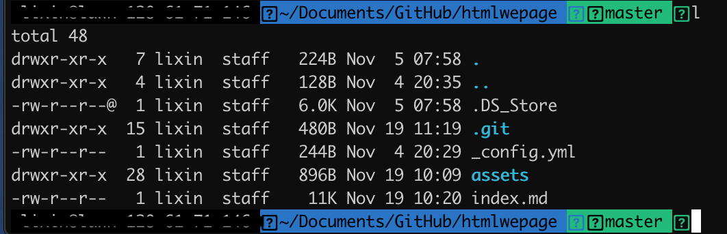
Using a Jekyll Theme
I used the “midnight” Jekyll theme for my webpage
List of Jekyll themes for Github Pages: https://pages.github.com/themes/
Changing themes just involves editing and reconfiguring the _config.yml. File in your github page repository

Slide 11
Work Flow Demonstration
Begin all projects by first cloning your webpage’s repo to your local work environment (git clone <your github page handle>)
Editing Markdown, Config, and html files
File Management and Access
Committing to master branch and pushing to origin

Slide 12
Design Choices

Slide 13

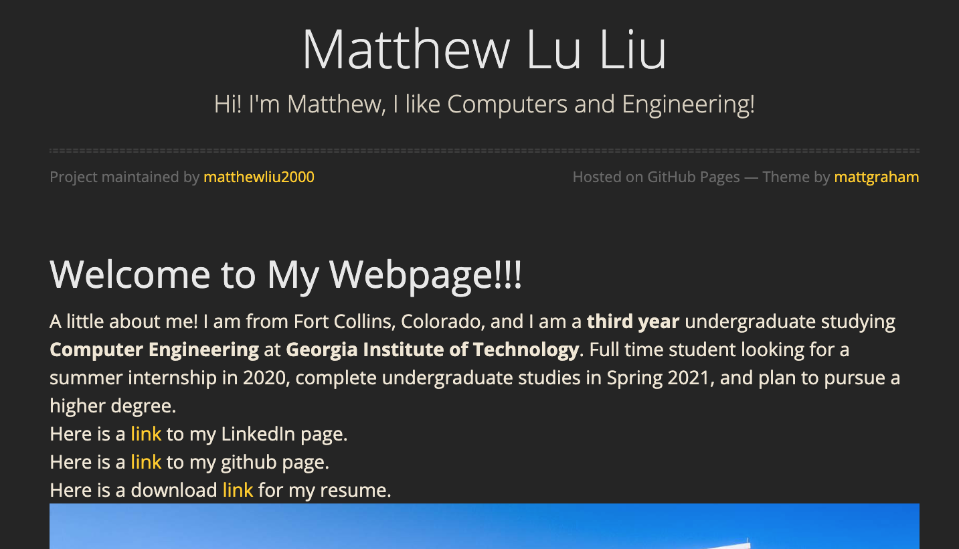
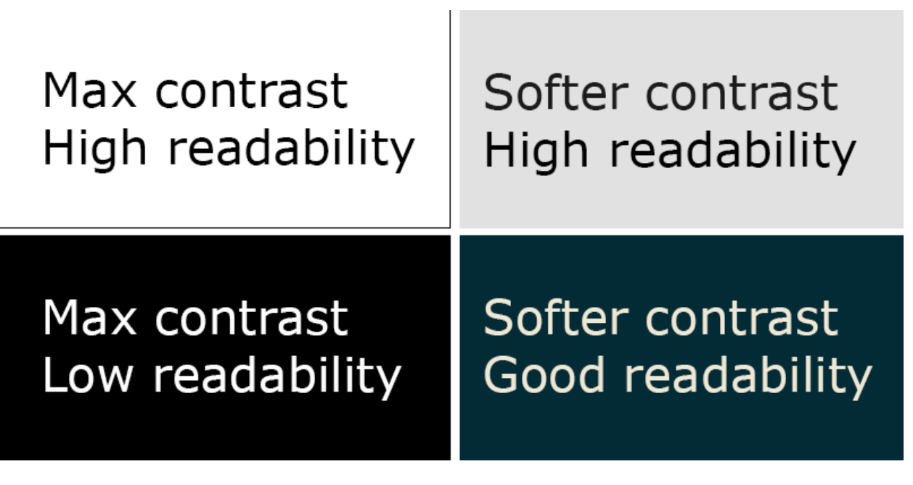
Using a dark/midnight jekyll theme
Dark themes are popular for coding
Easier to highlight things, and media stands out a bit more
70% of software engineer developers use dark theme
100% contrast typically assumed harder to read (not used here)

Slide 14

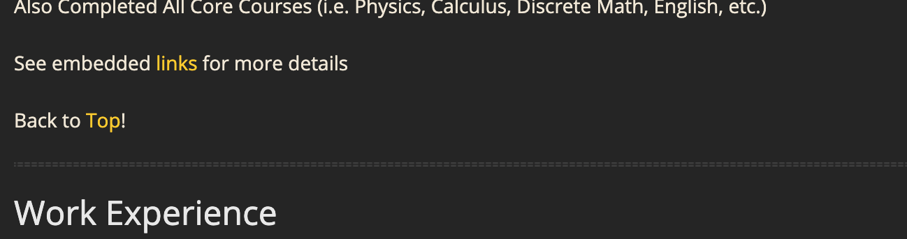
Navigation is improved with pointers across the page to jump to navigate between TOC and various different sections

Slide 15


Using Github pages helps demonstrate understanding and use of source code management and software development

Slide 16
Organization focuses on end-user
Introduction
Purpose: How to Create this Webpage
Quick Bio and Career Goal
Technical
Courses Completed by Spring 2020 (w/ descriptions)
Work Experience
Projects
Documents
Extracurricular
Activities
My Hobbies and Interests
Contact Information and Webpage Issue Support

Slide 17
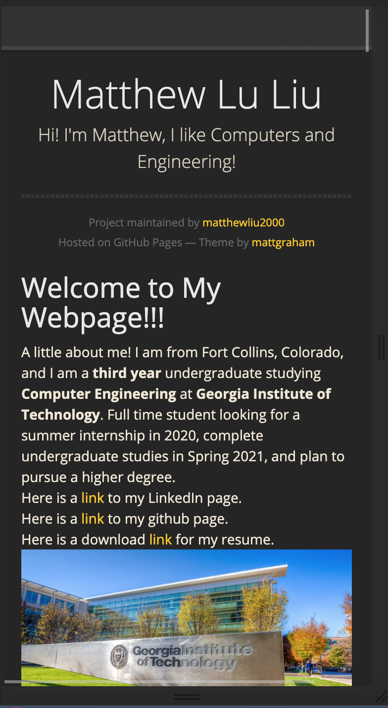
Details
Font: OpenSans
Website is mobile-friendly
Overall fairly simple design and UI

Slide 18
Future Work
It is possible to chain multiple webpages together with pointers in each from one and back to the other
Could create a homepage and multiple other separate pages detailing projects and work experience (especially good for projects controlled by github)
Changing default image sizes on webpage
Adding captions to images
Create Github Repositories for projects saved on my local computer
Social Media Integration (currently do not use a lot)
Create a “Front Page”

Slide 19
Overview of Required Components
Summary / Introduction
Vision / Purpose (value statement)
Career Goals
Resume
(1) 4-6 page technical writing sample
(2) 1-3 pages short writing samples
(1) Technical Presentation

Slide 20
Thanks for listening! Any Questions?

